Slide 1

Working with Chat Completions Part 3

Slide 2
Eduardo Paes
“There is no time and space in the digital world. People chat and collaborate through social networks. Cultural icons garner millions of fans online in locations they have often never been themselves. The boundary between public and private life is now everyone's business.”

Slide 3
What Are Our Options?
messages
model
frequency_penalty
logit_bias
logprobs
top_logprobs
max_tokens
n
presence_penalty
response_format
seed
stop
stream
temperature
top_p
tools
tool_choice
user
Notes:
https://platform.openai.com/docs/api-reference/chat/create

Slide 4
Banning or Keeping Tokens
The logit_bias argument
Notes:
https://platform.openai.com/docs/api-reference/chat/create#chat-create-logit_bias

Slide 5
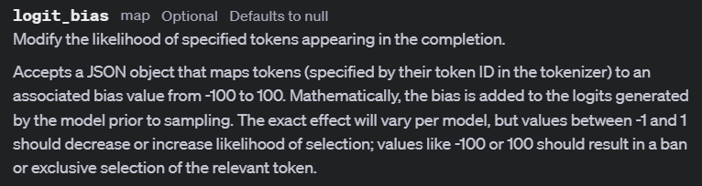
Notes:
https://platform.openai.com/docs/api-reference/chat/create#chat-create-logit_bias

Slide 6
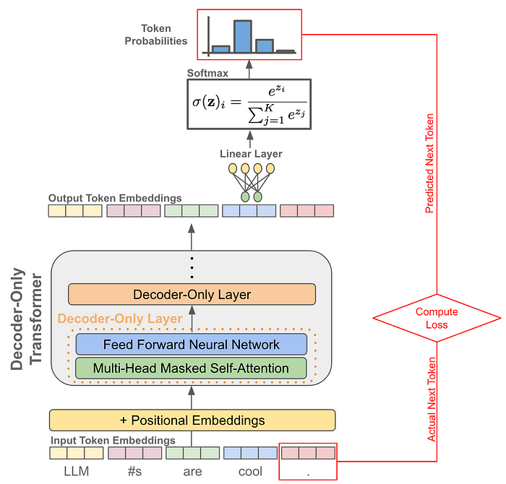
Prediction
Logits

Slide 7
Streaming
The stream argument
Notes:
https://platform.openai.com/docs/api-reference/chat/create#chat-create-stream

Slide 8
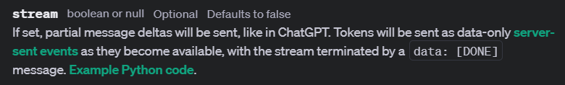

Slide 9


